Slide 1
Pulumi: Love and Azure
Lode Kennes

Slide 2

Lode Kennes
.NET Developer @ Axxes
Web API’s
Cloud first applications in Azure
React, React Native
Consultant @ Syneton

Slide 3


Topics
What is IAC?
Introduction to Pulumi
Demo
Tips & tricks
Questions

Slide 4
What is IAC?

Slide 5
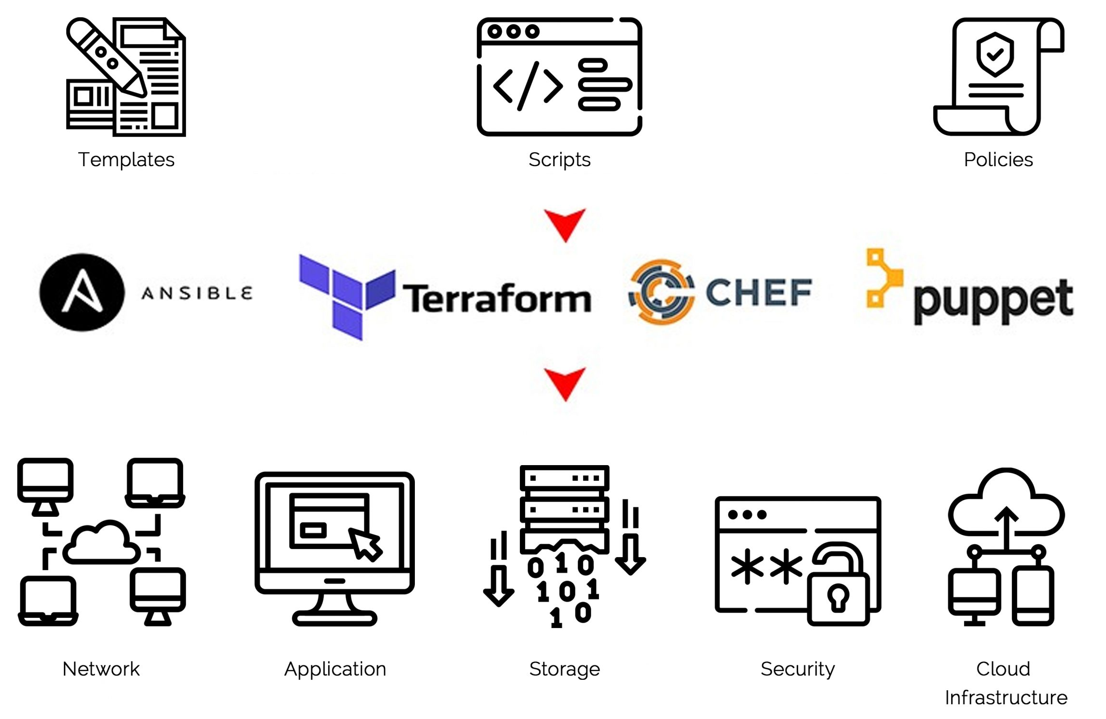
What is IAC?
Infrastructure as code
Maintaining / provisioning infrastructure through code
CI / CD pipeline
Dev = Acc = Prod = Good :)
Infrastructure is versioned
Notes:
You’re gonna transform the way you maintain infrastructure from clicking everything together to writing code which comes with a few advantages.
CI/CD which allows you to look at when things have changed online and what/who triggered it. No longer has to be run on your local pc.

Slide 6
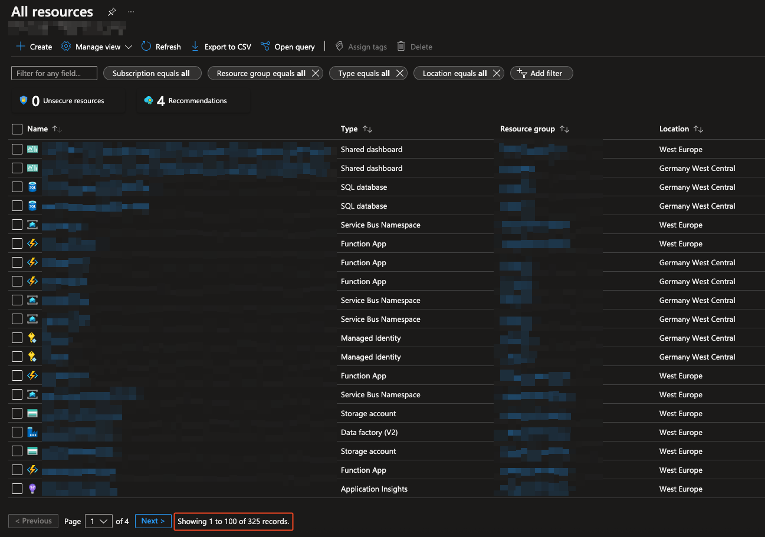




Who changed what?
WHAT CHANGED?!
When was it changed?
Why did it change?
Is everything exactly the same in each environment?
What was the setting?

Slide 7
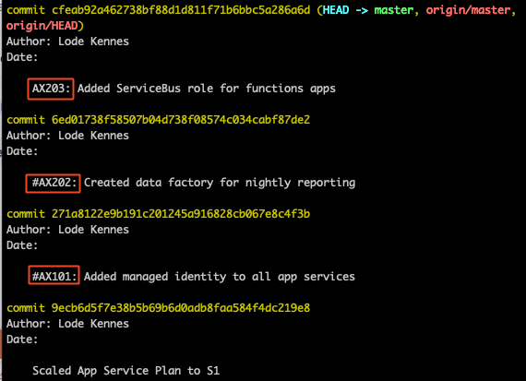
GIT Log
Notes:
Answering a few of the previous questions: a nice git log with a centralized feed of who changed what would is AWESOME. You can also attach this to tickets and see who changed what, when and WHY.

Slide 8
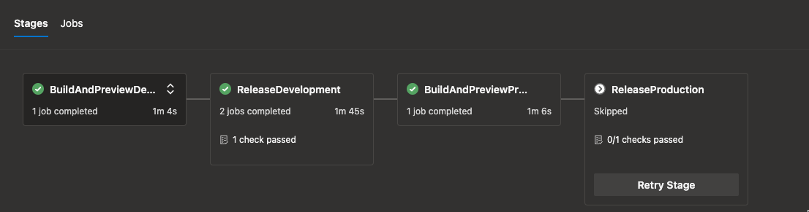
CI/CD
Notes:
Every CI/CD change flows through your UI. If you wanna have manual approval flows or automatically have infrastructure updated right before updating your code. So you’ll no longer have the issue when a piece of infrastructure is not created when deploying your code.
I’ve literally have it had happen that a queue was created for acc and dev but was forgotten for production. What a joy figuring that out right after you released your software.

Slide 9
Introduction to Pulumi
Notes:
Now that we’ve talked about the general concepts of IAC it’s time to talk about today’s topic: Pulumi.

Slide 10

Introduction to Pulumi
Pulumipus
Seattle
Free for 1 member
Azure, AWS, GCP
Notes:
Introduction to my friend the pulumipus. He’s from Seattle, the online version is free for 1 member so if you wanna try it out, please go ahead.
Why don't developers trust Pulumipus at parties?
Because it always tries to orchestrate everything!

Slide 11
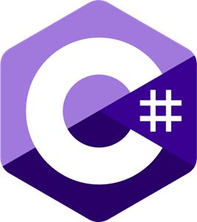
Introduction to Pulumi
TypeScript
Python
Go
C#
Java
YAML
Notes:
One of the main advantages and reasons why Pulumi is pretty entry level is the fact that you can use many programming languages.

Slide 12
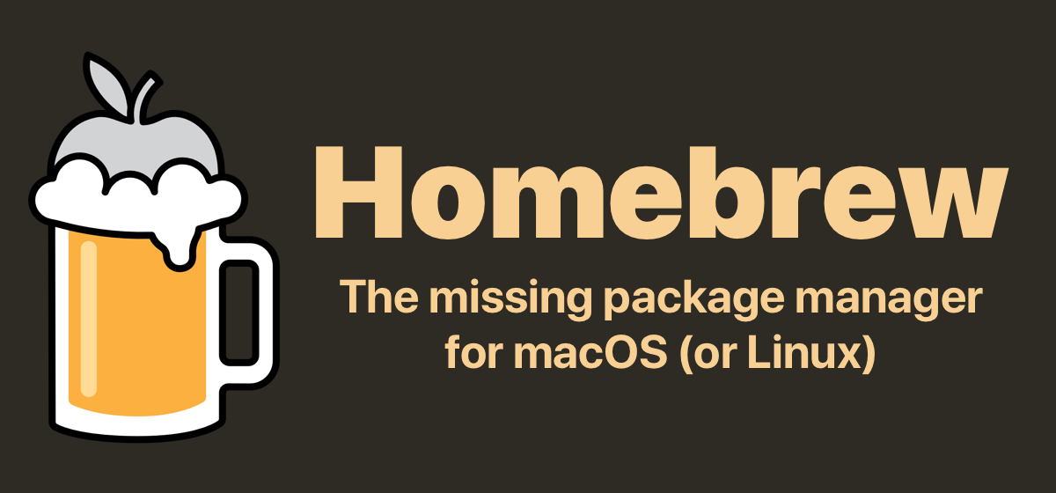

Getting started
1. $ brew install pulumi/tap/pulumi
> choco install pulumi
2. Install .NET
3. Install the azure cli & login
4. $ pulumi new azure-csharp
Notes:
Linux users, please refer to the docs!

Slide 13
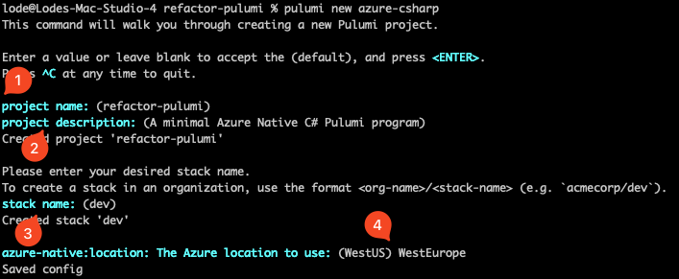
pulumi new azure-csharp

Slide 14
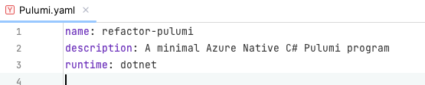
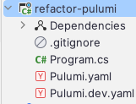
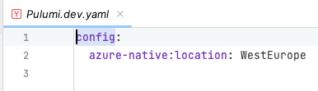
pulumi new azure-csharp

Slide 15
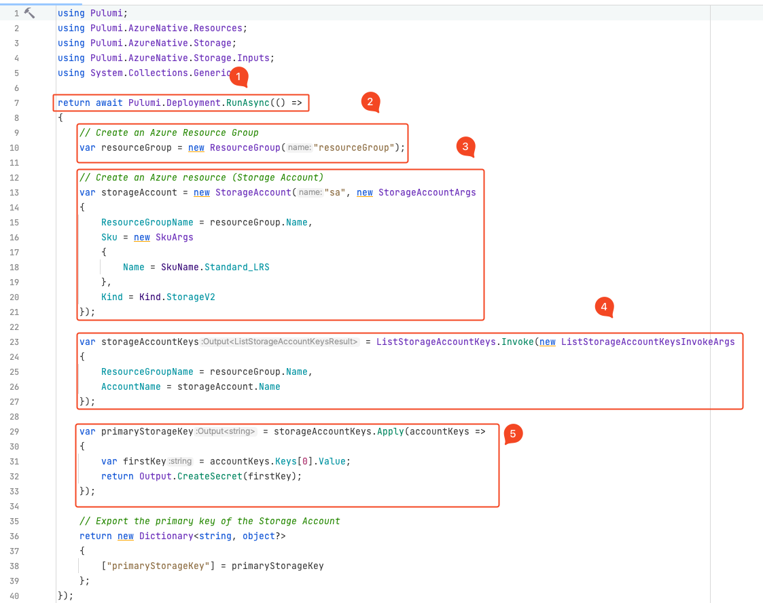
pulumi new azure-csharp

Slide 16
pulumi new azure-csharp

Slide 17
pulumi new azure-csharp

Slide 18
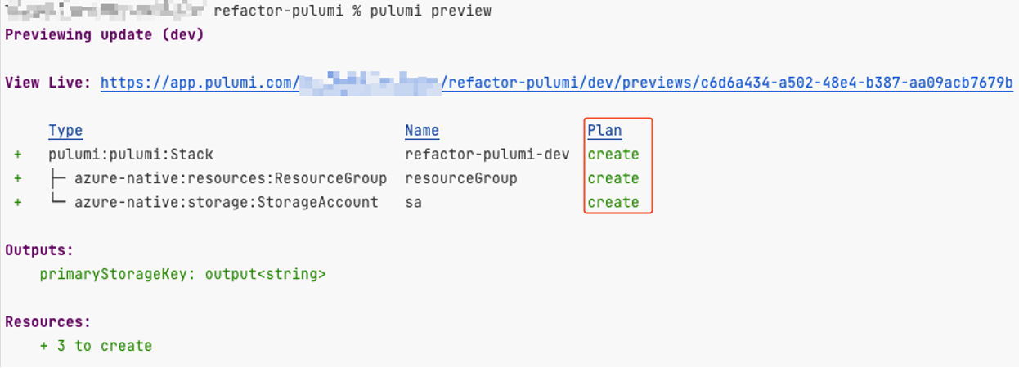
pulumi new azure-csharp

Slide 19
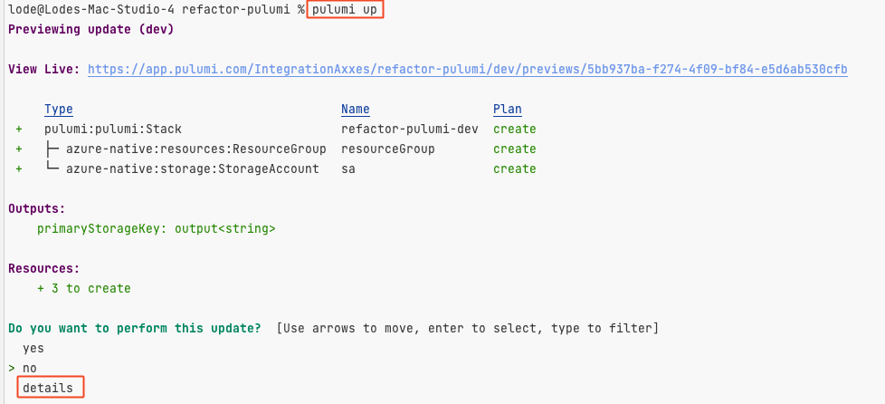
pulumi new azure-csharp

Slide 20
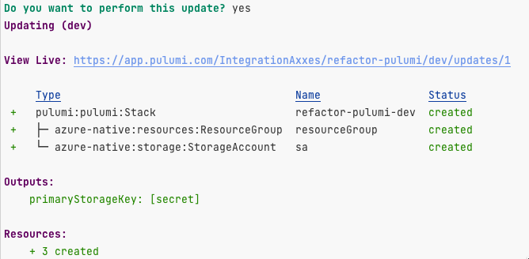
pulumi new azure-csharp

Slide 21
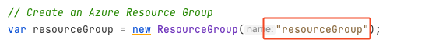
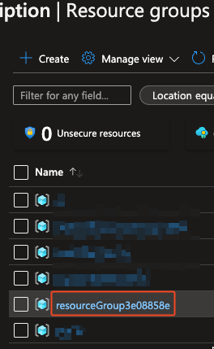
pulumi new azure-csharp
Automatic suffix
+ Resource name always unique
- Ugly name

Slide 22
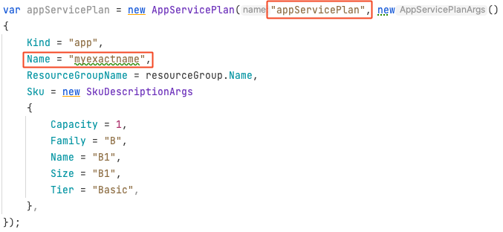
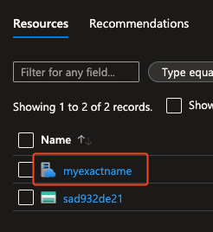
pulumi new azure-csharp

Slide 23
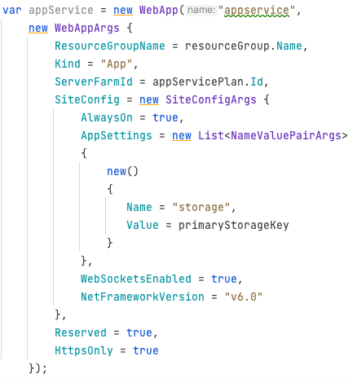
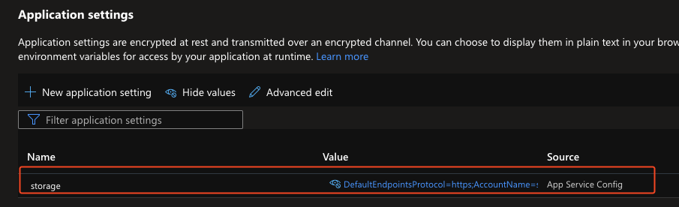
pulumi new azure-csharp

Slide 24
Demo
Notes:
Do pulumi up
Show the webportal
Add Application insights
Add SQL Server

Slide 25
Tips & tricks

Slide 26
Tips & tricks
Put everything in Pulumi
Configs
Secrets
Use proper names for your resources ➔ Don’t use ‘resourcegroup’ as your resource group name
Look at micro stacks for distributed applications
Separate stack per microservice
Everything deployable seperately
Use a service principal for authentication ➔ Prevent users for modifying resources manually

Slide 27
Misconceptions
IAC is dangerous, “what if some resources get deleted all of a sudden?”
I’ll start using IAC later, it’s not necessary at the start
IAC is hard

Slide 28
Thanks for watching
Questions?

